Slide 1


Nombre: Luis Salas
Fecha: 14/12/24

Slide 2
Outline
Executive Summary
Introduction
Methodology
Results
Conclusion
Appendix

Slide 3
Executive Summary
Publicly available data has been collected, processed and analyzed to build and validate multi-variable predictive classification models for the outcome of space missions.
The selected model proved to be reliable with an 85% accuracy predicting the outcome of a
mission landing the booster for future reuse.
Also, additional insights were gained during the process, including exploratory data analysis and visualization. Some examples are:
Success rate has a strong correlation with the flight number. This is an unequivocal trend showing that there is a steep learning curve in this field. This is crucial information for us, Space Y, as a new player in this market and will help us overcome this challenges.
We know which launch/landing sites (KSC LC-39A) and combination of booster versions/architectures (FT) and payload masses (<5000kg) have the highest success rate
We also know which orbits are more demanded by potential customers and their associated risks

Slide 4
Introduction
Space Y is a new company aiming to revolutionize the field of space exploration and exploitation using cost-efficient, reliable, reusable and sustainable rockets.
We will leverage from existing public data of our competitors and governmental space agencies to overcome our late arrival in the market.
In order to prepare our first strategic plan, we will rely on out departments of Data Science and Design to help predict launch outcomes based on multivariable analysis.
This derived insights will be used to adapt our plans accordingly
Development: select specific Booster design options that are more reliable
Deployment: select the best possible launch sites
Funding: estimate costs throughout the lifecycle of the project

Slide 5

Section 1
5

Slide 6
Methodology
Executive Summary
Data collection methodology:
Data was collected using web scrapping techniques and data APIs from publicly available sites obtaining a large enough data set with multiple variables.
Perform data wrangling
Data was processed and cleaned using the best practices and methodologies to ensure data completeness (e.g., replacing missing data) and consistency, and proper format and precision (e.g., converting categorical variables and then also numerical variables to double precision floats) required for the analysis and modeling techniques we used.
Perform exploratory data analysis (EDA) using visualization and SQL
Perform interactive visual analytics using Folium and Plotly Dash
Perform predictive analysis using classification models
Several models were developed and tuned using cross-validation techniques. Finally, the deployed model was validated using specific test data to avoid overfitting and estimate its predictive accuracy.
6

Slide 7
Data Collection – SpaceX API
Launch raw data obtained with REST API (requests.get method) at https://api.spacexdata.com/v4/launches/past
JSON response converted to Pandas DataFrame
IDs in raw data used to gather additional useful information like Booster Versions, Payload and Cores data, and Launch Sites names and coordinates through specific REST interfaces (launchpads, rockets, payloads and cores)
Data was then filtered to only investigate Falcon 9 historical launches.
Basic Data Wrangling performed to replace missing Payloads with the overall average value.
Data collection and
formatting
Raw Data
v0
Data collection
Raw Data v1
Preliminary Data Wrangling
Partially Clean Data
https://api.spacexdata.com/v4
/launches/past
https://api.spacexdata.com
/v4/rockets/
https://api.spacexdata.com
/v4/launchpads/
https://api.spacexdata.com
/v4/payloads/
https://api.spacexdata.com
/v4/cores/
GitHub URL: Semana-10/jupyter-labs-spacex-data-collection-api-v2-Luis-Salas.ipynb at main · IngSalass/Semana-10

Slide 8
Data Collection - Scraping
Raw Data collected from HTML tables from Wikipedia using web scraping technique (requests.get)
Iteratively Extracting and Parsing the information from the tables (BeatifulSoup)
Converting to a Pandas DataFrame
object.
Data Collection
Raw Data v0
Extracting and Parsing Data of interest (BeatifulSoup)
Raw Data v1
https://en.wikipedia.org/w/index.php?title=List_of_Falcon_9_and_Falco n_Heavy_launches&oldid=1027686922
GitHub URL:Semana-10-v2/jupyter-labs-webscraping-v2-Luis-Salas.ipynb at main · IngSalass/Semana-10-v2

Slide 9
Data Wrangling
Data was checked for consistency (missing data, data format, etc.)
Launch Sites and Types of Orbits basic statistics were explored
Outcomes of the mission were explored. This column combines outcome and
attempted landing pad.
We create new label as we are only interested in the landing outcome. It is a binary
metric named “Class”: 0 for failures and 1 for successful landings.
At a later stage (EDA), we also created dummy variables with OneHotEncoder to
convert categorical into binary (numeric) variables for modelling.
GitHub URL: semana-10v3/labs-jupyter-spacex-Data wrangling-v3-Luis-Salas.ipynb at main · IngSalass/semana-10v3

Slide 10
EDA with Data Visualization
The following Charts were developed as we want to explore if there are any correlations between the different variables.
“Relationship between Flight Number and Launch Site”
“Relationship between Payload and Launch Site”
“Relationship between success rate of each orbit type”
“Relationship between Flight Number and Orbit type”
“Relationship between Payload and Orbit type”
“Launch success yearly trend”
GitHub URL: semana-10v4/jupyter-labs-eda-sql-coursera_sqllite-v4-Luis-Salas.ipynb at main · IngSalass/semana-10v4

Slide 11
EDA with SQL
The following SQL queries were performed using %sql magic commands:
Unique launch sites: select distinct Launch_Site from SPACEXTBL limit 100
5 records where launch sites begin with the string 'CCA’: select * from SPACEXTBL where Launch_Site LIKE 'CCA%' limit 5
total payload mass carried by boosters launched by NASA (CRS): select sum(PAYLOAD_MASS KG_) from SPACEXTBL where Customer ='NASA (CRS)'
average payload mass carried by booster version F9 v1.1: select avg(PAYLOAD_MASS KG_) from SPACEXTBL where Booster_Version = 'F9 v1.1’
date for the first successful landing outcome in ground pad: select min(Date) from SPACEXTBL where Landing_Outcome not like '%Failure%'
names of the boosters which have success in drone ship and payload mass greater than 4000 but less than 6000: select distinct Booster_Version from SPACEXTBL where Landing_Outcome = 'Success (drone ship)' and PAYLOAD_MASS KG_ > 4000 and PAYLOAD_MASS KG_ < 6000 limit 10
total number of successful and failure mission outcomes: select distinct Mission_Outcome from SPACEXTBL
names of the booster_versions which have carried the maximum payload mass: select Booster_Version,max(PAYLOAD_MASS KG_) from SPACEXTBL where PAYLOAD_MASS KG_ = (select max(PAYLOAD_MASS KG_) from SPACEXTBL ) limit 1
month names, failure landing_outcomes in drone ship ,booster versions, launch_site for the months in year 2015: select substr(Date,
6,2),Booster_Version, Launch_Site from SPACEXTBL where Landing_Outcome = 'Failure (drone ship)' and substr(Date,0,5)='2015'
Rank the count of landing outcomes: select Landing_Outcome,count(Landing_Outcome) as n from SPACEXTBL where Date between '2010-06-04' and '2017-03-20' group by Landing_Outcome order by n desc
GitHub URL: Semana-10-v5/jupyter-labs-eda-sql-coursera_sqllite-v5-Luis-Salas.ipynb at main · IngSalass/Semana-10-v5

Slide 12
Build an Interactive Map with Folium
Circles and Markers were created at the NASA Headquarter and all Launch Sites to
show their location.
Lines and additional Markers were created to show distance from one selected Launch Site to the nearest Railway/Highway, Coastline and City as we want to explore logistics and safety aspects of the sites.
Markers within Marker Clusters were created to show the total number of launches and their outcome from each site and a color used to represent if it was successful (green) or a failure (red) since we want to understand if a there is any correlation between Location/site and success rate.
GitHub URL:Semana-10v6/lab-jupyter-launch-site-location-v6-Luis-Salas.ipynb at main · IngSalass/Semana-10v6

Slide 13
Build a Dashboard with Plotly Dash
A dropdown box was used to select the Site of interest. You can select any of the different Launch Sites or All if you want to analyze global information.
This dropdown menu interacts with and control two different plots:
A Pie Chart to show the success rate for the selected site or the proportion of successful launches for all the sites
A Scatter plot of Outcome (class) vs Payload Mass in kg, differentiating with colors the Booster Version Category.
In order to analyze different Payload Mass ranges for the scatter plot, we created and interactive Slider where
you can pick the minimum and maximum mass of interest.
We are interested in understanding if the Launch Site has any influence in the success rate and also whether the Booster Version Category and Payload Mass also correlates with success.
13

Slide 14
Predictive Analysis (Classification)
We implemented 4 different classification models: Logistic Regression, Support Vector Machines, Tree and K-Neighbors.
Data was split into Train (80%) and Test (20%) data
Preselected HyperParameters were optimized for each model to obtain the best performance
(“accuracy”) using Train data and 10 folds with Cross Validation (GridSearchCV)
Accuracy Scores were obtained for model performance with train and test data.
Confusion Matrix then examined on test data to confirm the model is sufficiently generalized.
GitHub URL:
Executed on Cloud Environment => Semana-10/jupyter-labs-spacex-data-collection-api-v2-Luis-Salas.ipynb at main · IngSalass/Semana-10
Executed Locally with other parameters => semana-10v3/labs-jupyter-spacex-Data wrangling-v3-Luis-Salas.ipynb at main · IngSalass/semana-10v3

Slide 15
Results
Exploratory data analysis results
Interactive analytics demo in screenshots
Predictive analysis results

Slide 16

Section 2

Slide 17
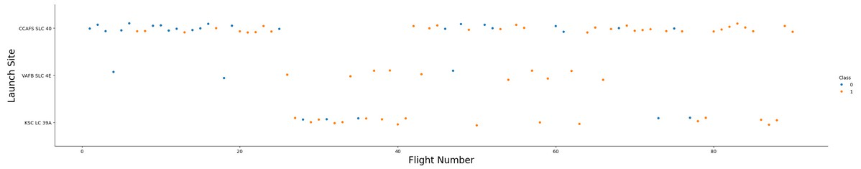
Flight Number vs. Launch Site
Site CCAFS SLC-40 and VAFB SLC 4E were used for the first 20+ launches with not too good results.
Site CCAFS SLC-40 wasn’t used for a period of time (flights 25-40), but used again since flight number 40 and there after with much better outcomes.
Site VAFB SLC 4E has been much less used than the other sites.
Site KSC LC-39A was probably not available until flight 25, and used intensively until flight ~41, and more sporadically there after,
but with good overall outcomes.

Slide 18
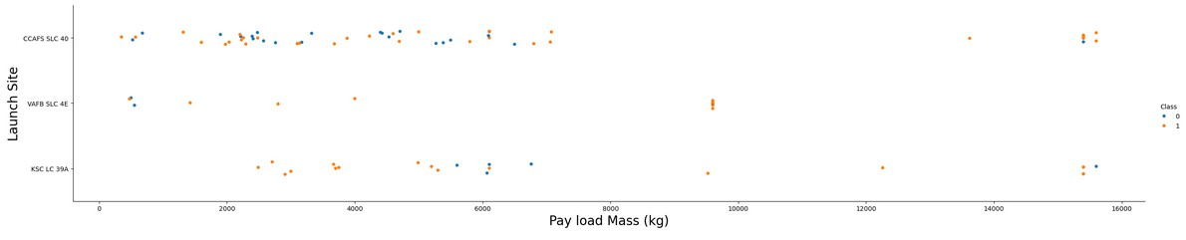
Payload vs. Launch Site
There is not any clear correlation between the explored variables. However, we notice the following
Site VAFB SLC 4E has never been used for payloads larger than 10000kg
Site CCAFS SLC-40 has been used for low and large payload masses with modest success rate
Site KSC LC-39A has been used for intermediate and large payloads, with very good success rate.

Slide 19
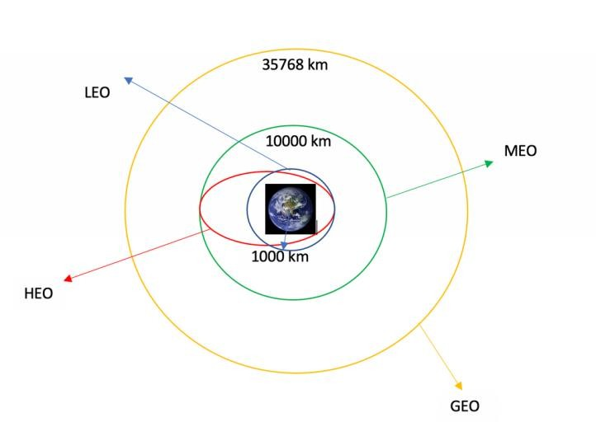
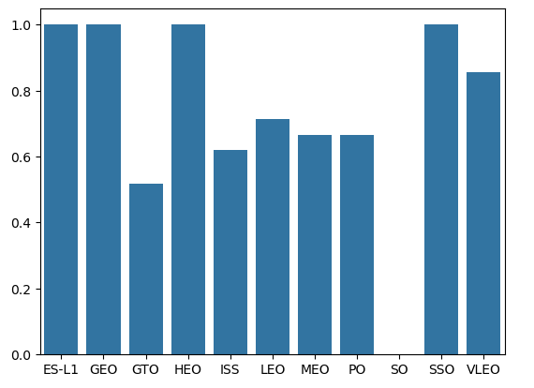
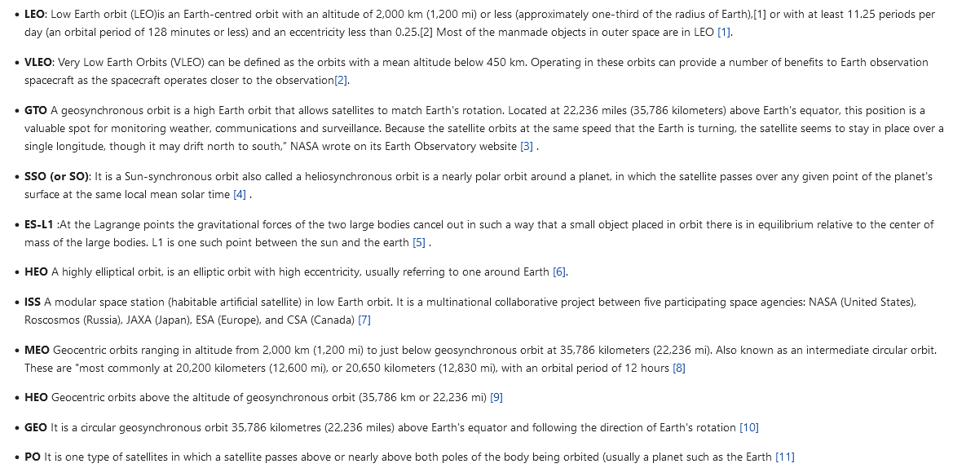
Success Rate vs. Orbit Type
The orbits with the highest success rates are ES-L1, GEO, HEO and
SSO.
The orbits with the lowest success rates are SO and GTO.

Slide 20
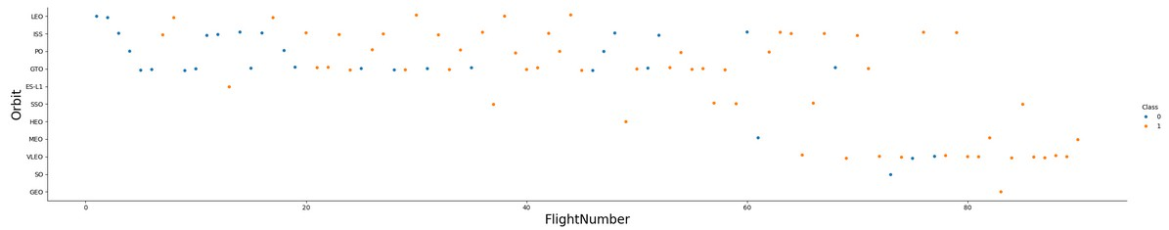
Flight Number vs. Orbit Type
Certain orbits were only exploited or accesible after a certain number of flights. This might be due to technological limitations or strategical decisions. For example, Very Low Earth Orbits became popular and successful since flight number ~62
GTO geosynchronous and Low Earth Orbits (LEO) were very frequent at the beginning, probably aiming for communication services like Starlink. Also, the ISS to service the station in agreement with NASA.

Slide 21
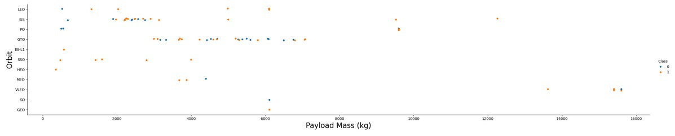
Payload vs. Orbit Type
Large Payloads (masses beyond 10000kg) are not frequently launched and only to specific orbits
A Payload Mass vs Flight Number/Date chart would help understand certain trends better (i.e. mass limitations on previous Booster versions)

Slide 22
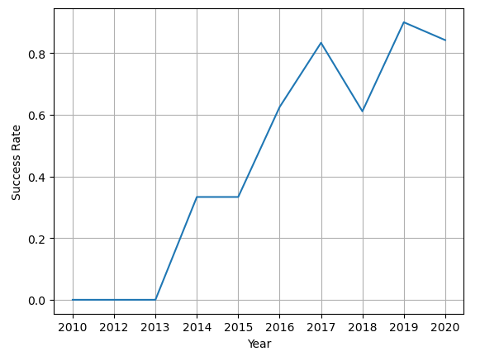
Launch Success Yearly Trend
Success rate was initially zero until 2013.
Success rate since 2013 kept increasing till 2017 (stable in 2014) probably because of the lessons learned the previous years.
It dropped in 2018, maybe due to new developments, and raised again in 2019, remaining very high (>80%) thereafter.

Slide 23

All Launch Site Names
There are 4 different Launch Sites:
%sql select distinct Launch_Site from SPACEXTBL limit 100
Launch_Site
CCAFS LC-40
VAFB SLC-4E
KSC LC-39A
CCAFS SLC-40

Slide 24

Launch Site Names Begin with 'CCA'
We get the required 5 records with all its associated data with the following statement:
%sql select * from SPACEXTBL where Launch_Site LIKE 'CCA%' limit 5
Date | Time (UTC) | Booster_Versio n | Launch_Site | Payload | PAYLOAD_M ASS KG_ | Orbit | Customer | Mission_Outco me | Landing_Outco me
2010-06-04 | 18:45:00 | F9 v1.0 B0003 | CCAFS LC-40 | Dragon Spacecraft Qualification Unit | 0 | LEO | SpaceX | Success | Failure (parachute)
2010-12-08 | 15:43:00 | F9 v1.0 B0004 | CCAFS LC-40 | Dragon demo flight C1, two CubeSats, barrel of Brouere cheese | 0 | LEO (ISS) | NASA (COTS) NRO | Success | Failure (parachute)
2012-05-22 | 7:44:00 | F9 v1.0 B0005 | CCAFS LC-40 | Dragon demo flight C2 | 525 | LEO (ISS) | NASA (COTS) | Success | No attempt
2012-10-08 | 0:35:00 | F9 v1.0 B0006 | CCAFS LC-40 | SpaceX CRS-1 | 500 | LEO (ISS) | NASA (CRS) | Success | No attempt
2013-03-01 | 15:10:00 | F9 v1.0 B0007 | CCAFS LC-40 | SpaceX CRS-2 | 677 | LEO (ISS) | NASA (CRS) | Success | No attempt

Slide 25

Total Payload Mass
The total payload carried by boosters from NASA was 45596 kg
%sql select sum(PAYLOAD_MASS KG_) from SPACEXTBL where Customer ='NASA (CRS)’
sum(PAYLOAD_MASS KG_)
45596

Slide 26

Average Payload Mass by F9 v1.1
The average payload mass carried by booster version F9 v1.1 was 2928.4kg
%sql select avg(PAYLOAD_MASS KG_) from SPACEXTBL where Booster_Version = 'F9 v1.1'
avg(PAYLOAD_MASS KG_)
2928.4

Slide 27

First Successful Ground Landing Date
The first successful landing outcome on ground pad was on May 22nd, 2012
%sql select min(Date) from SPACEXTBL where Landing_Outcome not like '%Failure%’
min(Date)
2012-05-22

Slide 28

Successful Drone Ship Landing with Payload between 4000 and 6000
There are 4 boosters which have successfully landed on drone ship and had payload mass greater than 4000 but less than 6000. All of them type “F9 FT” as seen below:
%sql select distinct Booster_Version from SPACEXTBL where Landing_Outcome = 'Success (drone ship)' and PAYLOAD_MASS KG_ > 4000 and PAYLOAD_MASS KG_ < 6000 limit 10
Booster_Version
F9 FT B1022
F9 FT B1026
F9 FT B1021.2
F9 FT B1031.2

Slide 29

Total Number of Successful and Failure Mission Outcomes
Below you can see the total number of successful and failure mission outcomes.
%sql select Mission_Outcome,count(*) from SPACEXTBL group by Mission_Outcome
Mission_Outcome | count(*)
Failure (in flight) | 1
Success | 98
Success | 1
Success (payload status unclear) | 1

Slide 30

Boosters Carried Maximum Payload
Booster F9 B5 B1048.4 have carried the maximum payload mass of 15600kg
%sql select Booster_Version,max(PAYLOAD_MASS KG_) from SPACEXTBL where PAYLOAD_MASS KG_ = (select max(PAYLOAD_MASS KG_) from SPACEXTBL )
Booster_Version | max(PAYLOAD_MASS KG_)
F9 B5 B1048.4 | 15600

Slide 31

2015 Launch Records
List of failed landing_outcomes in drone ship, their booster versions, and launch site names for in year 2015
%sql select substr(Date, 6,2) as Month ,Booster_Version, Launch_Site from SPACEXTBL where Landing_Outcome = 'Failure (drone ship)' and substr(Date,0,5)='2015'
Month | Booster_Version | Launch_Site
01 | F9 v1.1 B1012 | CCAFS LC-40
04 | F9 v1.1 B1015 | CCAFS LC-40

Slide 32

Rank Landing Outcomes Between 2010-06-04 and 2017-03-20
Ranking of landing outcomes between the date 2010-06-04 and 2017-03-20
%sql select Landing_Outcome,count(Landing_Outcome) as n from SPACEXTBL where Date
between '2010-06-04' and '2017-03-20' group by Landing_Outcome order by n desc
Landing_Outcome | n
No attempt | 10
Success (drone ship) | 5
Failure (drone ship) | 5
Success (ground pad) | 3
Controlled (ocean) | 3
Uncontrolled (ocean) | 2
Failure (parachute) | 2
Precluded (drone ship) | 1

Slide 33

Section 3

Slide 34
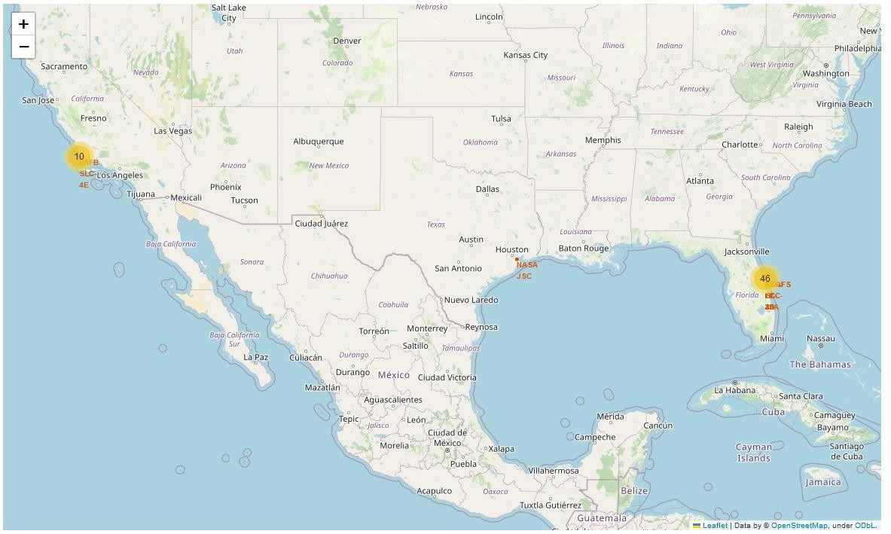
Launch Sites Locations
Launch Sites are shown and are located near coastline in Florida and California
They provide alternative launch windows within the USA.
NASA Headquarters are located in Houston

Slide 35
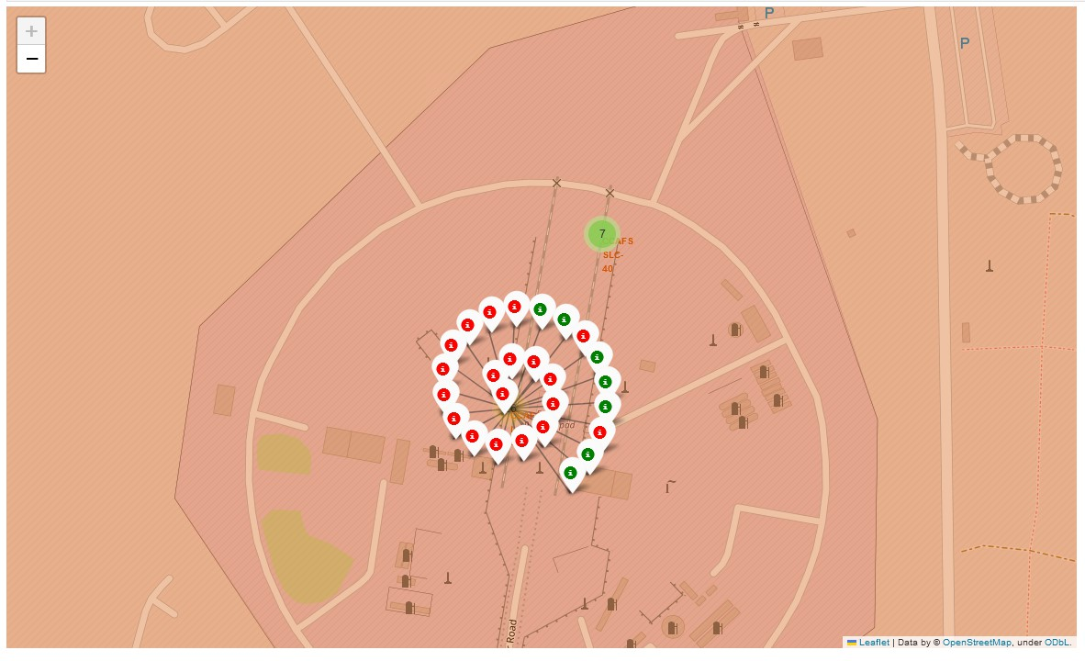
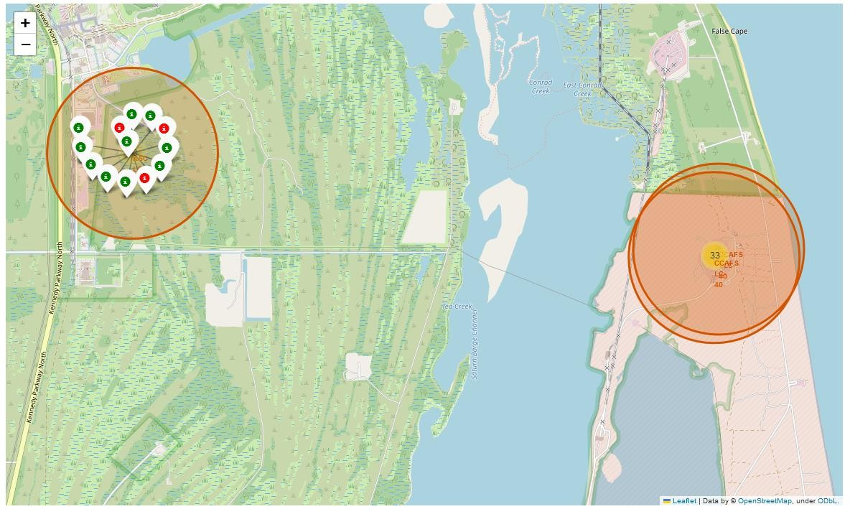
Success/Failed launches for each site
Two nearby sites in Florida are shown with their total number of successful (green) and failed (red) launches
KSC LC-39A has the best rate
CCAFS SLC-40 has the wors rate

Slide 36
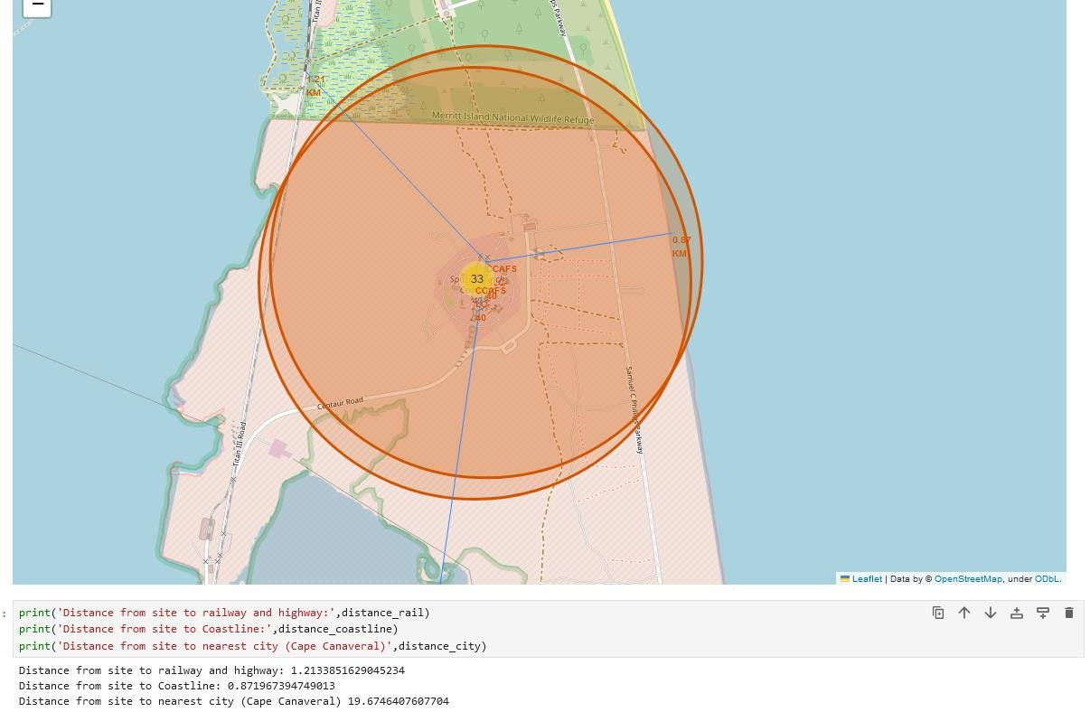
Distances between a launch site to its proximities
Distance markers and lines are shown from selected site to nearest:
Highway and Railway
Coastline
City (Cape Canaveral)
Launch sites are within 1 km of highways and railways because of logistics aspects.
For safety considerations, they are close to the coast (~1.2km) and far enough from cities (~20km).
36

Slide 37

Section 4

Slide 38
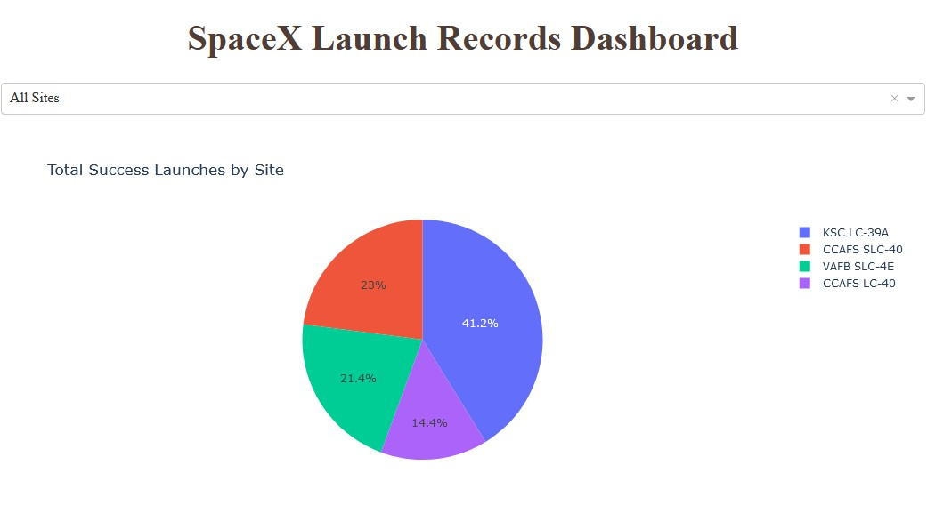
Total Success Launches by Site
“KSC LC-39A” is the site with more successful launches overall
Disclaimer:
It is important to note that this does not represent the success rate for each individual site, as this is not normalized by the number of launches in each site.
See next slide for
clarification.
38

Slide 39
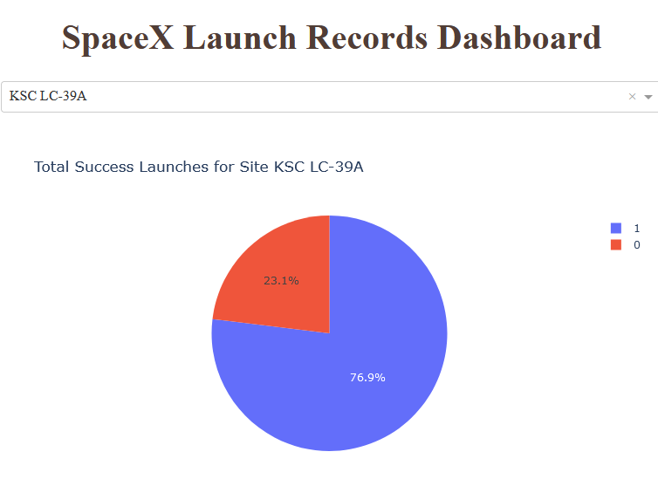
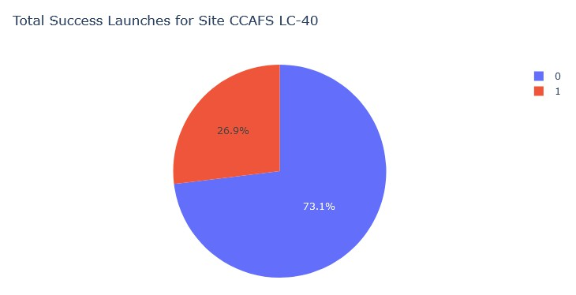
Sites with the best Success Rate
“KSC LC-39A” is not only the site with more successful launches overall, but also the
one with the highest success rate with ~77% positive outcomes.
“CCAFS LC-40” had the lowest overall number of successes but it is due to a low number of attempts, and its rate is very high (though statistically not significant).
39

Slide 40
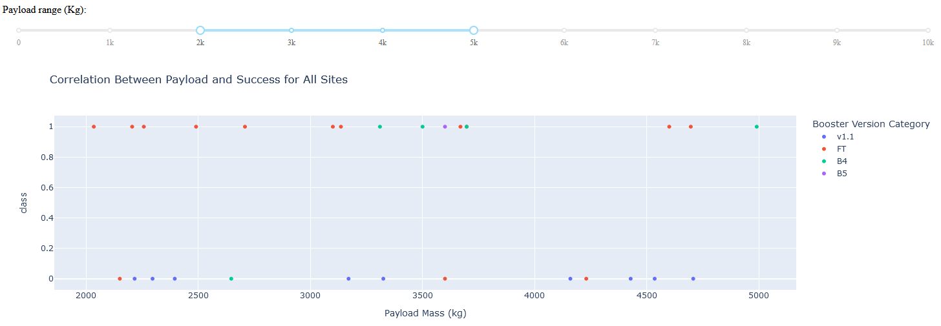
Correlation between Payload/Booster and Success (1)
We can see that for Payloads between 2000 and 5000 kg, Booster category FT was very successful

Slide 41
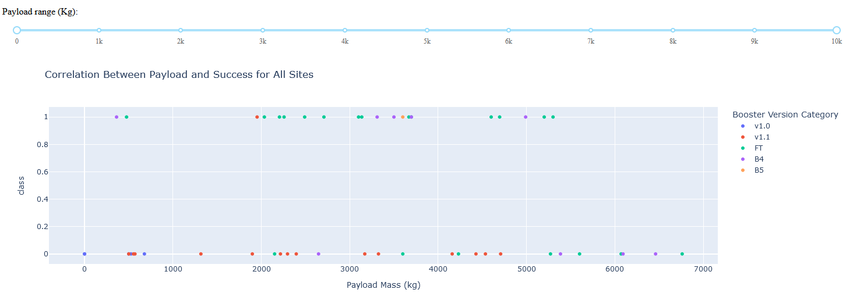
Correlation between Payload/Booster and Success (2)
Overall, Booster version 1.1 is the least successful one.
For payloads larger than 5500 kg, all attempts had failed

Slide 42

Section 5

Slide 43
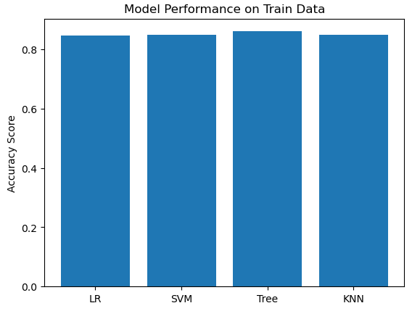
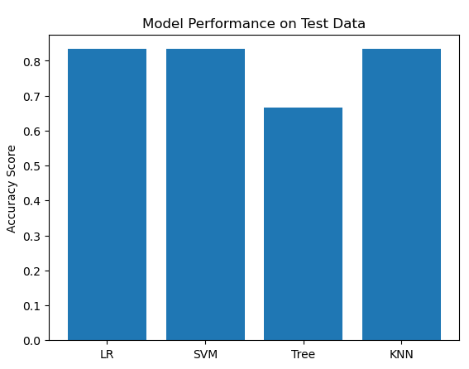
Classification Accuracy
Classification Tree suffers from overfitting with the extended parameters tested.
All other models perform roughly the same (85% accuracy)

Slide 44
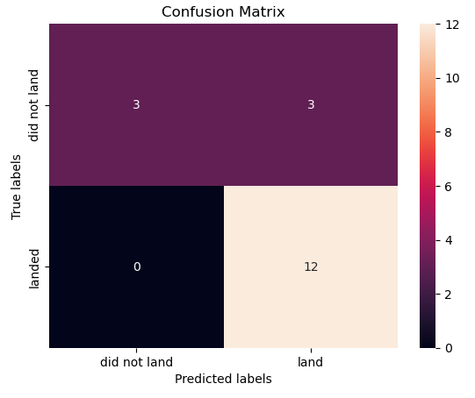
Confusion Matrix
Our prediction models based on classification algorithms performed well with an 85% accuracy.
However, there is a risk of obtaining False Positives on untrained data, that is, predicting a positive outcome when it will actually fail.
Further analysis and modelling is recommended to minimize this issue.

Slide 45
Conclusions
Success Rate has a strong correlation with flight number. This is a consequence of the steep learning curve required in this field, literally “rocket science”.
This is a very important conclusion that must be conveyed to Space Y management team and stakeholders.
Strategic plans must take this into account to be able to compete despite our late arrival to the market.
The selection of our headquarters and launch and landing sites is also crucial, not only for logistics and safety considerations, but also because they affect the success rate. Studying the specific characteristics of site KSC LC-39A could yield important factors to understand its high success rate.
Booster category FT carrying payloads up to 5000kg maximum has the highest success rate of all.
Our classification model can predict the outcome of a mission with an 85% accuracy.
Some false positives predictions can happen.
Additional investigation, including new data and modelling techniques is recommended to update and improve the
quality of our models.

Slide 46
Appendix
Source code, and this presentation/report, is available here:

Slide 47


